Slide 1
Probabilistic Programming
Marius Popescu
popescunmarius@gmail.com
2018 - 2019

Slide 2
Variational Bayesian Methods
From Variational Inference to Variational Autoencoders

Slide 3
Variational Bayesian Methods
Variational Bayesian methods are a family of techniques for approximating intractable integrals arising in Bayesian inference and machine learning. They are typically used in complex statistical models consisting of observed variables (usually termed "data") as well as unknown parameters and latent variables, with various sorts of relationships among the three types of random variables.
Variational Bayesian methods are primarily used for two purposes:
To provide an analytical approximation to the posterior probability of the unobserved variables, in order to do statistical inference over these variables.
To derive a lower bound for the marginal likelihood (sometimes called the "evidence") of the observed data (i.e. the marginal probability of the data given the model, with marginalization performed over unobserved variables). This is typically used for performing model selection, the general idea being that a higher marginal likelihood for a given model indicates a better fit of the data by that model and hence a greater probability that the model in question was the one that generated the data.

Slide 4
Variational Inference

Slide 5
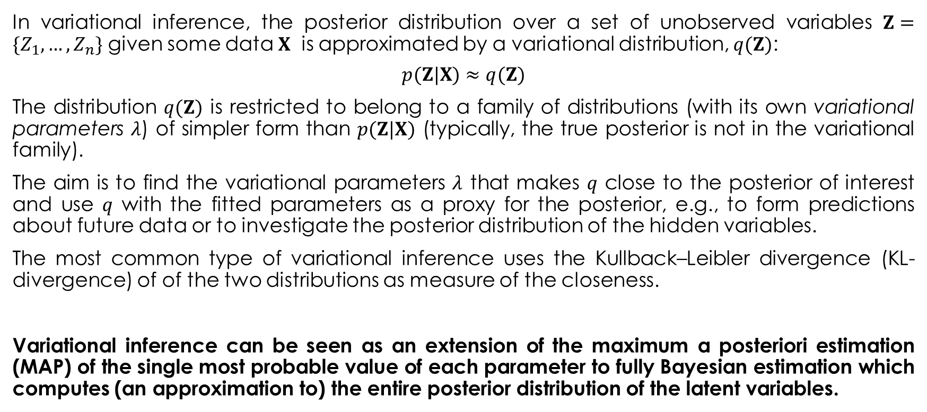
Variational Inference
In variational inference, the posterior distribution over a set of unobserved variables $Z=\{Z_{1},…,Z_{n}\}$ given some data $X$ is approximated by a variational distribution, $q(Z)$:
$$p(Z|X)≈q(Z)$$
The distribution $q(Z)$ is restricted to belong to a family of distributions (with its own variational parameters $λ$) of simpler form than $p(Z|X)$ (typically, the true posterior is not in the variational family).
The aim is to find the variational parameters $λ$ that makes $q$ close to the posterior of interest and use $q$ with the fitted parameters as a proxy for the posterior, e.g., to form predictions about future data or to investigate the posterior distribution of the hidden variables.
The most common type of variational inference uses the Kullback–Leibler divergence (KL-divergence) of of the two distributions as measure of the closeness.
Variational inference can be seen as an extension of the maximum a posteriori estimation (MAP) of the single most probable value of each parameter to fully Bayesian estimation which computes (an approximation to) the entire posterior distribution of the latent variables.

Slide 6

KL-divergence comes from Information Theory

Slide 7
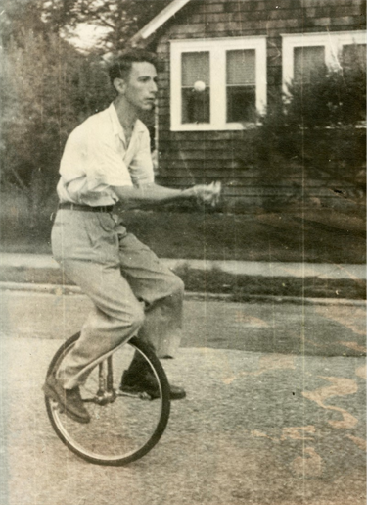
Information Theory
In the early 1940s it was thought to be impossible to send information at a positive rate with negligible probability of error. Shannon surprised the communication theory community by proving that the probability of error could be made nearly zero for all communication rates below channel capacity. The capacity can be computed simply from the noise characteristics of the channel. Shannon further argued that random processes such as music and speech have an irreducible complexity below which the signal cannot be compressed. This he named the entropy, in deference to the parallel use of this word in thermodynamics, and argued that if the entropy of the source is less than the capacity of the channel, asymptotically error-free communication can be achieved.
Information theory answers two fundamental questions in communication theory: What is the ultimate data compression (answer: the entropy H), and what is the ultimate transmission rate of communication (answer: the channel capacity C).

Slide 8
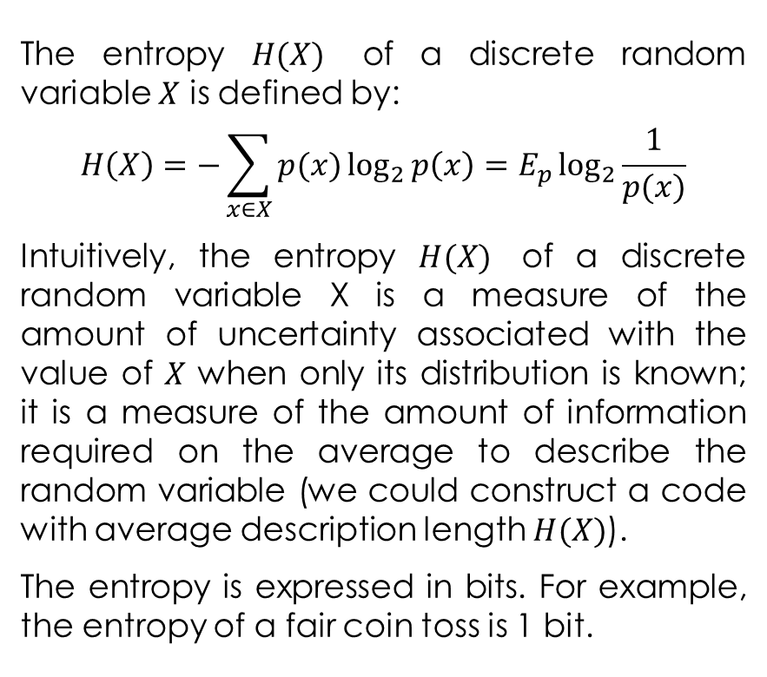
The Entropy
The entropy $H(X)$ of a discrete random variable $X$ is defined by:
$$H\left(X\right)=−\sum_{x∈X}{p(x)\log_{2}{p\left(x\right)=E_{p}\log_{2}{\frac{1}{p(x)}}}}$$
Intuitively, the entropy $H(X)$ of a discrete random variable X is a measure of the amount of uncertainty associated with the value of $X$ when only its distribution is known; it is a measure of the amount of information required on the average to describe the random variable (we could construct a code with average description length $H(X)$).
The entropy is expressed in bits. For example, the entropy of a fair coin toss is 1 bit.

Slide 9
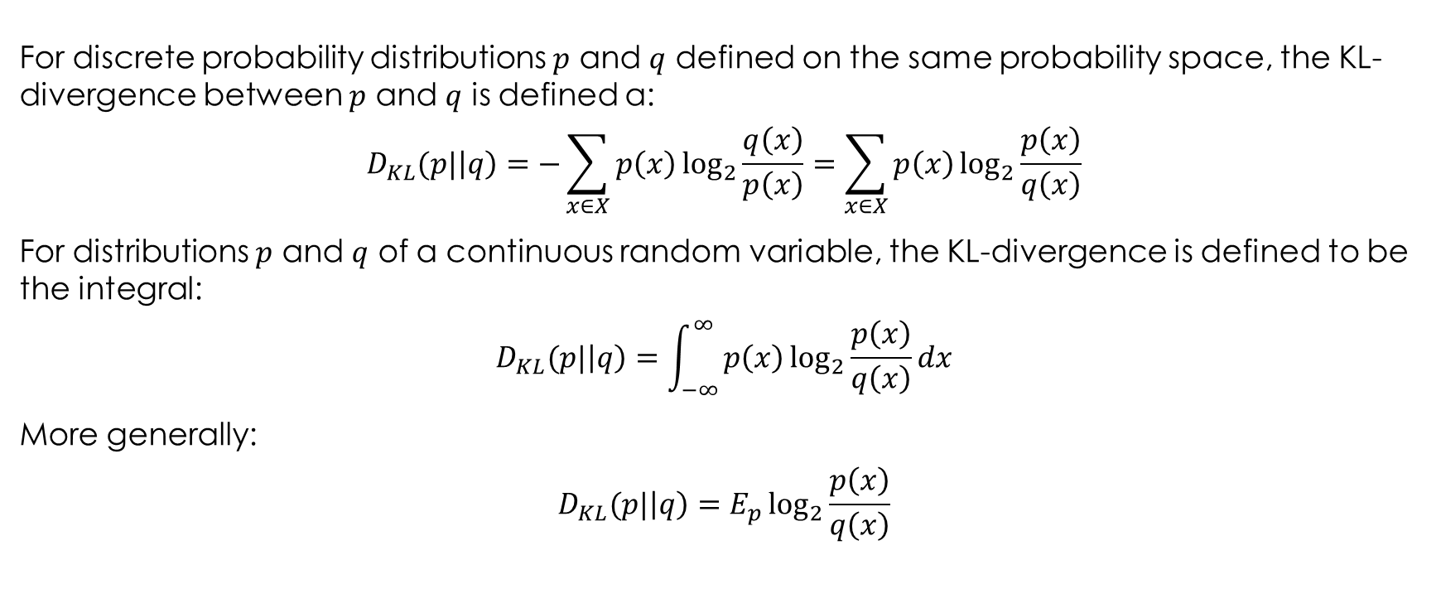
Kullback–Leibler Divergence
For discrete probability distributions $p$ and $q$ defined on the same probability space, the KL-divergence between $p$ and $q$ is defined a:
$$D_{KL}(p|\left|q\right)=−\sum_{x∈X}{p\left(x\right)\log_{2}{\frac{q\left(x\right)}{p\left(x\right)}}}=\sum_{x∈X}{p\left(x\right)\log_{2}{\frac{p\left(x\right)}{q\left(x\right)}}}$$
For distributions $p$ and $q$ of a continuous random variable, the KL-divergence is defined to be the integral:
$$D_{KL}(p|\left|q\right)=\int_{−∞}^{∞}{p\left(x\right)\log_{2}{\frac{p\left(x\right)}{q\left(x\right)}}dx}$$
More generally:
$$D_{KL}(p|\left|q\right)=E_{p}\log_{2}{\frac{p\left(x\right)}{q\left(x\right)}}$$

Slide 10
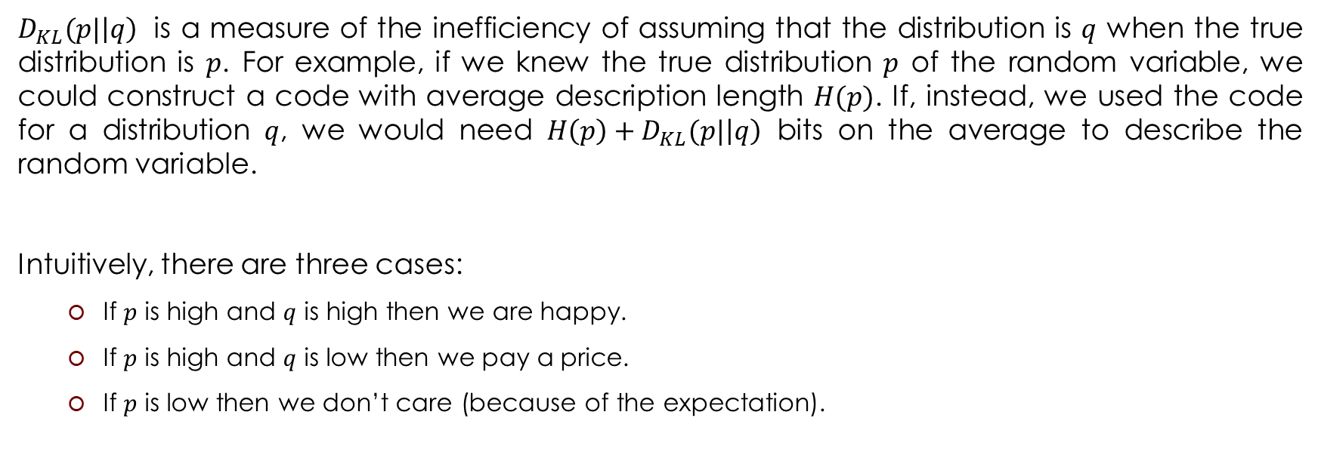
Kullback–Leibler Divergence
$D_{KL}(p|\left|q\right)$ is a measure of the inefficiency of assuming that the distribution is $q$ when the true distribution is $p$. For example, if we knew the true distribution $p$ of the random variable, we could construct a code with average description length $H(p)$. If, instead, we used the code for a distribution $q$, we would need $H\left(p\right)+D_{KL}(p|\left|q\right)$ bits on the average to describe the random variable.
Intuitively, there are three cases:
If $p$ is high and $q$ is high then we are happy.
If $p$ is high and $q$ is low then we pay a price.
If $p$ is low then we don’t care (because of the expectation).

Slide 11


Coming Back to Variational Inference
Note that $q$ and $p$ are reversed from what one might expect
We want:
$$\min{D_{KL}(q(Z)|\left|p(Z|X)\right)}$$

Slide 12
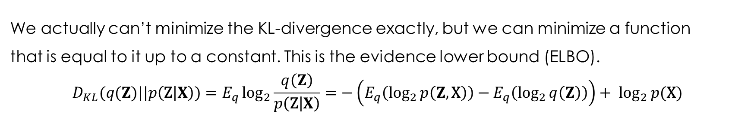
The Evidence Lower Bound (ELBO)
We actually can’t minimize the KL-divergence exactly, but we can minimize a function
that is equal to it up to a constant. This is the evidence lower bound (ELBO).
$$D_{KL}(q(Z)||p\left(\text{Z} | X\right))=E_{q}\log_{2}{\frac{q\left(Z\right)}{p\left(\text{Z} | X\right)}}=−\left(E_{q}\left(\log_{2}{p\left(Z,\text{X}\right)}\right)−E_{q}\left(\log_{2}{q\left(Z\right)}\right)\right)+ \log_{2}{p(\text{X})}$$
ELBO
Notice that $\log_{2}{p(\text{X})}$ does not depend on $q$. So, as a function of the variational distribution, minimizing the KL-divergence is the same as maximizing the ELBO.

Slide 13
Example: Probabilistic PCA

Slide 14
Probabilistic PCA
Probabilistic principal components analysis (PCA) is a dimensionality reduction technique that analyzes data via a lower dimensional latent space. Probabilistic PCA generalizes classical PCA. It is often used when there are missing values in the data or for multidimensional scaling.

Slide 15
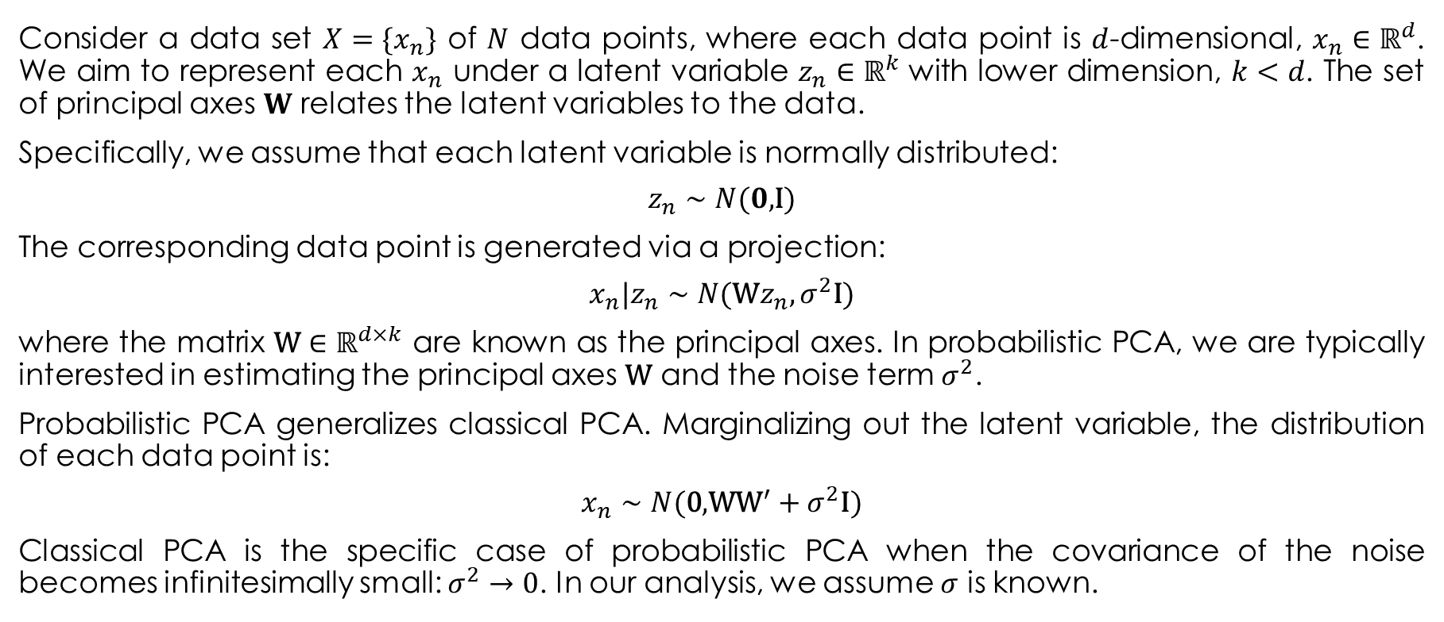
The Model
Consider a data set $X=\{x_{n}\}$ of $N$ data points, where each data point is $d$-dimensional, $x_{n}∈ℝ^{d}$. We aim to represent each $x_{n}$ under a latent variable $z_{n}∈ℝ^{k}$ with lower dimension, $k<d$. The set of principal axes $W$ relates the latent variables to the data.
Specifically, we assume that each latent variable is normally distributed:
$$z_{n}∼N(0\text{,}\text{I})$$
The corresponding data point is generated via a projection:
$$x_{n}|z_{n}∼N(\text{W}z_{n},σ^{2}\text{I})$$
where the matrix $\text{W}∈ℝ^{d×k}$ are known as the principal axes. In probabilistic PCA, we are typically interested in estimating the principal axes $\text{W}$ and the noise term $σ^{2}$.
Probabilistic PCA generalizes classical PCA. Marginalizing out the latent variable, the distribution of each data point is:
$$x_{n}∼N(\text{0}\text{,}\text{W}{\text{W}}^{′}+σ^{2}\text{I})$$
Classical PCA is the specific case of probabilistic PCA when the covariance of the noise becomes infinitesimally small: $σ^{2}→0$. In our analysis, we assume $σ$ is known.

Slide 16
The Model in TFP
def probabilistic_pca(data_dim, latent_dim, num_datapoints, stddv_datapoints): # (unmodeled) data
w = ed.Normal(loc=tf.zeros([data_dim, latent_dim]),
scale=2.0 * tf.ones([data_dim, latent_dim]),
name="w") # parameter
z = ed.Normal(loc=tf.zeros([latent_dim, num_datapoints]),
scale=tf.ones([latent_dim, num_datapoints]),
name="z") # parameter
x = ed.Normal(loc=tf.matmul(w, z),
scale=stddv_datapoints * tf.ones([data_dim, num_datapoints]),
name="x") # (modeled) data
return x, (w, z)
log_joint = ed.make_log_joint_fn(probabilistic_pca)

Slide 17
Using the Edward2 Model to Generate Data
num_datapoints = 5000
data_dim = 2
latent_dim = 1
stddv_datapoints = 0.5
model = probabilistic_pca(data_dim=data_dim,
latent_dim=latent_dim,
num_datapoints=num_datapoints,
stddv_datapoints=stddv_datapoints)
with tf.Session() as sess:
x_train, (actual_w, actual_z) = sess.run(model)
print("Principal axes:")
print(actual_w)

Slide 18
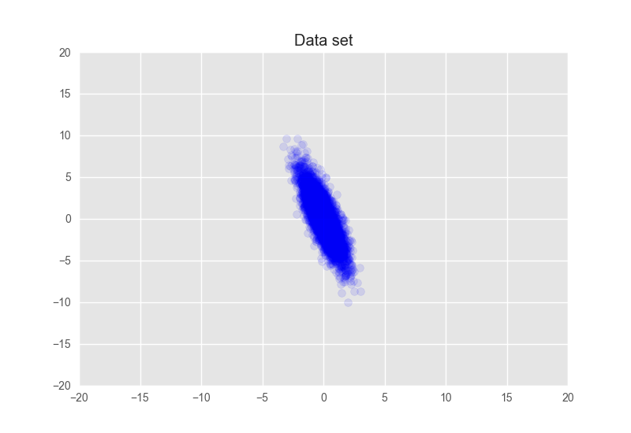
The Data
Principal axes:
[[-0.7300116]
[ 2.5360086]]

Slide 19
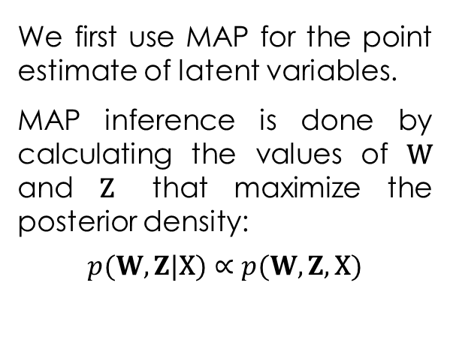
MAP Inference
tf.reset_default_graph()
w = tf.Variable(np.ones([data_dim, latent_dim]), dtype=tf.float32)
z = tf.Variable(np.ones([latent_dim, num_datapoints]), dtype=tf.float32)
def target(w, z):
"""Unnormalized target density as a function of the parameters."""
return log_joint(data_dim=data_dim,
latent_dim=latent_dim,
num_datapoints=num_datapoints,
stddv_datapoints=stddv_datapoints,
w=w, z=z, x=x_train)
energy = -target(w, z)
optimizer = tf.train.AdamOptimizer(learning_rate=0.05)
train = optimizer.minimize(energy)
We first use MAP for the point estimate of latent variables.
MAP inference is done by calculating the values of $\text{W}$ and $\text{Z}$ that maximize the posterior density:
$$p(W,Z|\text{X})∝p(W,Z,\text{X})$$

Slide 20
MAP Inference: Training
init = tf.global_variables_initializer()
t = []
num_epochs = 200
with tf.Session() as sess:
sess.run(init)
for i in range(num_epochs):
sess.run(train)
if i % 5 == 0:
cE, cw, cz = sess.run([energy, w, z])
t.append(cE)
w_inferred_map = sess.run(w)
z_inferred_map = sess.run(z)

Slide 21
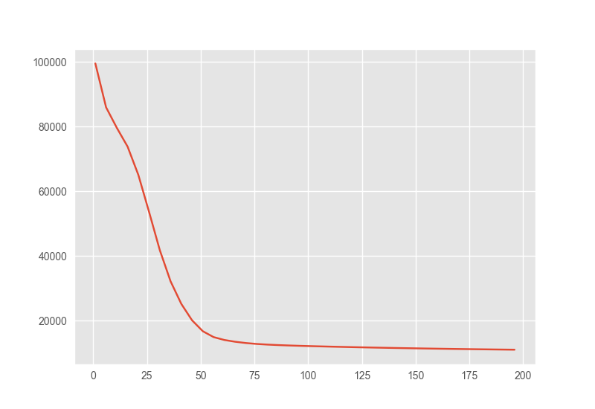
MAP Inference: Training

Slide 22
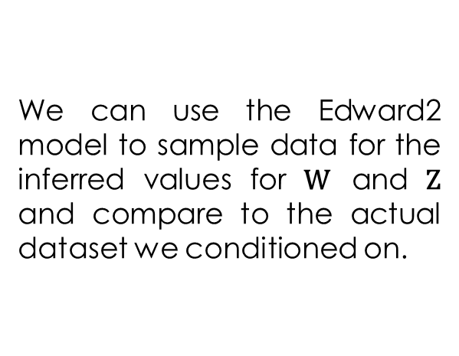
Criticism
def replace_latents(w=actual_w, z=actual_z):
def interceptor(rv_constructor, *rv_args, **rv_kwargs):
"""Replaces the priors with actual values to generate samples from."""
name = rv_kwargs.pop("name")
if name == "w":
rv_kwargs["value"] = w
elif name == "z":
rv_kwargs["value"] = z
return rv_constructor(*rv_args, **rv_kwargs)
return interceptor
with ed.interception(replace_latents(w_inferred_map, z_inferred_map)):
generate = probabilistic_pca(
data_dim=data_dim, latent_dim=latent_dim,
num_datapoints=num_datapoints, stddv_datapoints=stddv_datapoints)
with tf.Session() as sess:
x_generated, _ = sess.run(generate)
We can use the Edward2 model to sample data for the inferred values for $\text{W}$ and $\text{Z}$ and compare to the actual dataset we conditioned on.

Slide 23
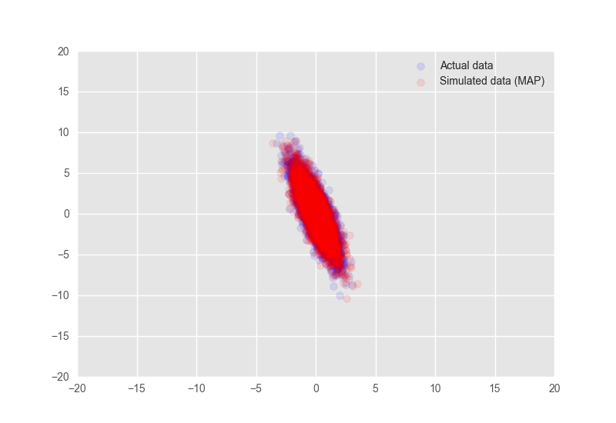
The Results
print("MAP-estimated axes:")
print(w_inferred_map)
MAP-estimated axes:
[[-0.8976625]
[ 3.1588674]]

Slide 24
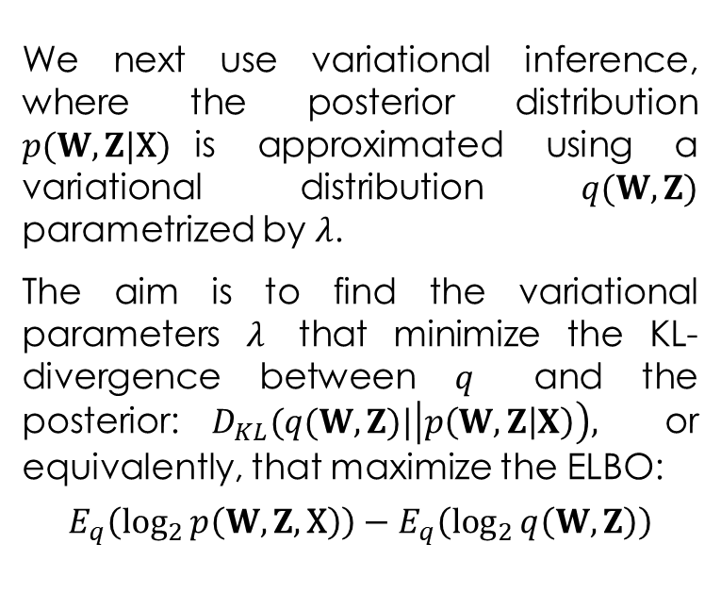
Variational Inference
tf.reset_default_graph()
def variational_model(qw_mean, qw_stddv, qz_mean, qz_stddv):
qw = ed.Normal(loc=qw_mean, scale=qw_stddv, name="qw")
qz = ed.Normal(loc=qz_mean, scale=qz_stddv, name="qz")
return qw, qz
log_q = ed.make_log_joint_fn(variational_model)
def target_q(qw, qz):
return log_q(qw_mean=qw_mean, qw_stddv=qw_stddv,
qz_mean=qz_mean, qz_stddv=qz_stddv,
qw=qw, qz=qz)
qw_mean = tf.Variable(np.ones([data_dim, latent_dim]), dtype=tf.float32)
qz_mean = tf.Variable(np.ones([latent_dim, num_datapoints]), dtype=tf.float32)
qw_stddv = tf.nn.softplus(tf.Variable(-4 * np.ones([data_dim, latent_dim]), dtype=tf.float32))
qz_stddv = tf.nn.softplus(tf.Variable(-4 * np.ones([latent_dim, num_datapoints]), dtype=tf.float32))
qw, qz = variational_model(qw_mean=qw_mean, qw_stddv=qw_stddv,
qz_mean=qz_mean, qz_stddv=qz_stddv)
energy = target(qw, qz)
entropy = -target_q(qw, qz)
elbo = energy + entropy
We next use variational inference, where the posterior distribution $p(W,Z|\text{X})$is approximated using a variational distribution $q(W,Z)$ parametrized by $λ$.
The aim is to find the variational parameters $λ$ that minimize the KL-divergence between $q$ and the posterior:$D_{KL}(q(W,Z)|\left|p\left(W,Z | X\right)\right),$ or equivalently, that maximize the ELBO:
$$E_{q}\left(\log_{2}{p\left(W,Z,\text{X}\right)}\right)−E_{q}\left(\log_{2}{q\left(W,Z\right)}\right)$$

Slide 25
Variational Inference: Training
optimizer = tf.train.AdamOptimizer(learning_rate = 0.05)
train = optimizer.minimize(-elbo)
init = tf.global_variables_initializer()
t = []
num_epochs = 100
with tf.Session() as sess:
sess.run(init)
for i in range(num_epochs):
sess.run(train)
if i % 5 == 0:
t.append(sess.run([elbo]))
w_mean_inferred = sess.run(qw_mean)
w_stddv_inferred = sess.run(qw_stddv)
z_mean_inferred = sess.run(qz_mean)
z_stddv_inferred = sess.run(qz_stddv)

Slide 26
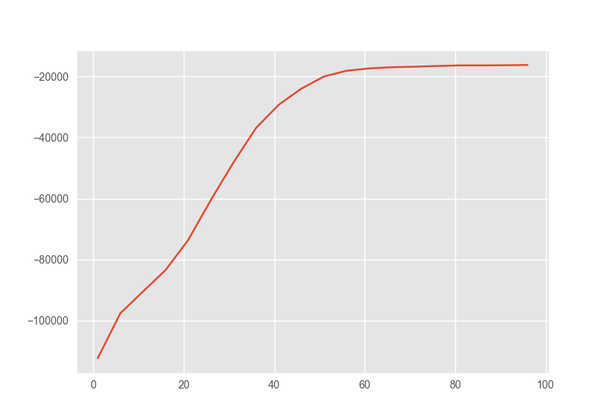
Variational Inference: Training

Slide 27
Criticism
print("Inferred axes:")
print(w_mean_inferred)
print("Standard Deviation:")
print(w_stddv_inferred)
with ed.interception(replace_latents(w_mean_inferred, z_mean_inferred)):
generate = probabilistic_pca(
data_dim=data_dim, latent_dim=latent_dim,
num_datapoints=num_datapoints, stddv_datapoints=stddv_datapoints)
with tf.Session() as sess:
x_generated, _ = sess.run(generate)
We can use the Edward2 model to sample data for the inferred values for $\text{W}$ and $\text{Z}$ and compare to the actual dataset we conditioned on.

Slide 28
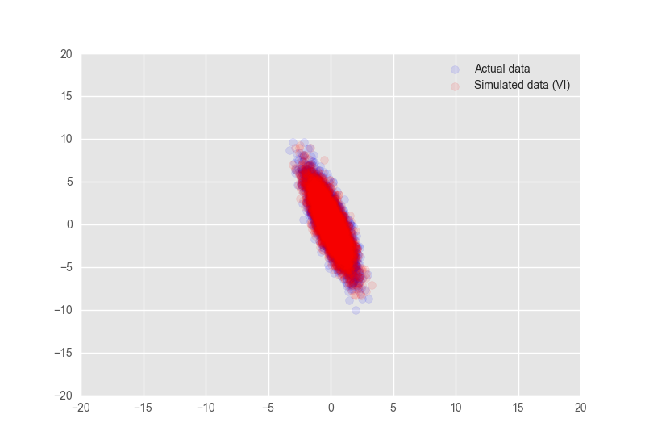
The Results
print("Inferred axes:")
print(w_mean_inferred)
print("Standard Deviation:")
print(w_stddv_inferred)
Inferred axes:
[[-0.6105784]
[ 2.141177 ]]
Standard Deviation:
[[0.01481778]
[0.0108717 ]]

Slide 29
VAE: Variational Autoencoders
Diederik Kingma and Max Welling. Auto-Encoding Variational Bayes. In International Conference on Learning Representations, 2014. (https://arxiv.org/abs/1312.6114)

Slide 30
Autoencoders
An autoencoder is a machine learning model which uses one learned system to represent data in some low-dimensional space and a second learned system to restore the low-dimensional representation to what would have otherwise been the input.
The encoder converts the input data into an encoding vector where each dimension represents some learned attribute about the data. The decoder then subsequently takes these values and attempts to recreate the original input.

Slide 31
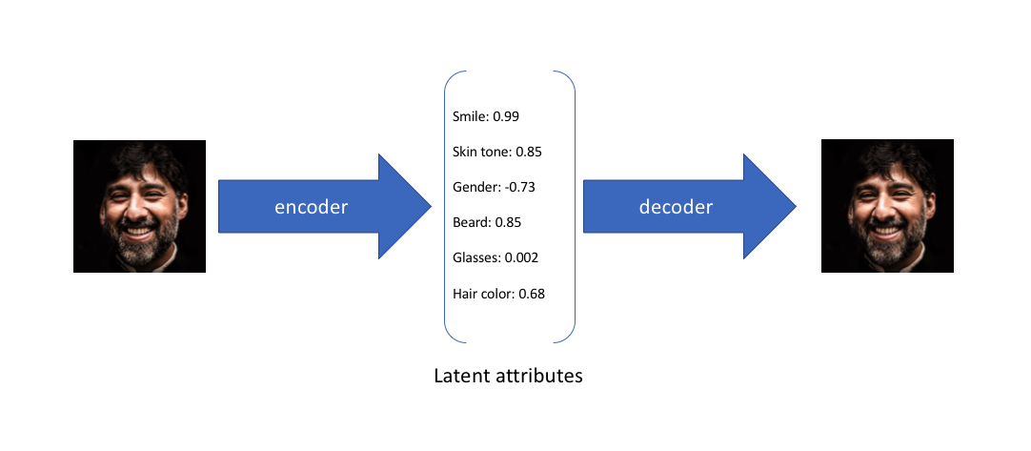
Autoencoders: Intuition
Let's suppose we've trained an autoencoder model on a large dataset of faces with a encoding dimension of 6. An ideal autoencoder will learn descriptive attributes of faces such as skin color, whether or not the person is wearing glasses, etc. in an attempt to describe an observation in some compressed representation:

Slide 32
VAE
A variational autoencoder (VAE) provides a probabilistic manner for describing an observation in latent space. Thus, rather than building an encoder which outputs a single value to describe each latent state attribute, we'll formulate our encoder to describe a probability distribution for each latent attribute.

Slide 33
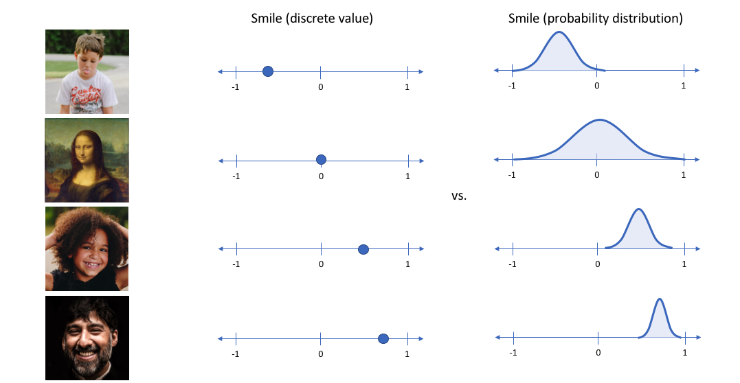
What single value would you assign for the smile attribute if you feed in a photo of the Mona Lisa?

Slide 34
VAE
By constructing our encoder model to output a range of possible values (a statistical distribution) from which we'll randomly sample to feed into our decoder model, we're essentially enforcing a continuous, smooth latent space representation. For any sampling of the latent distributions, we're expecting our decoder model to be able to accurately reconstruct the input. Thus, values which are nearby to one another in latent space should correspond with very similar reconstructions.

Slide 35
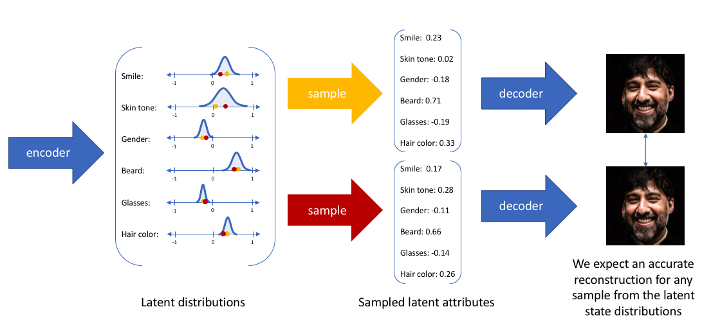

Slide 36
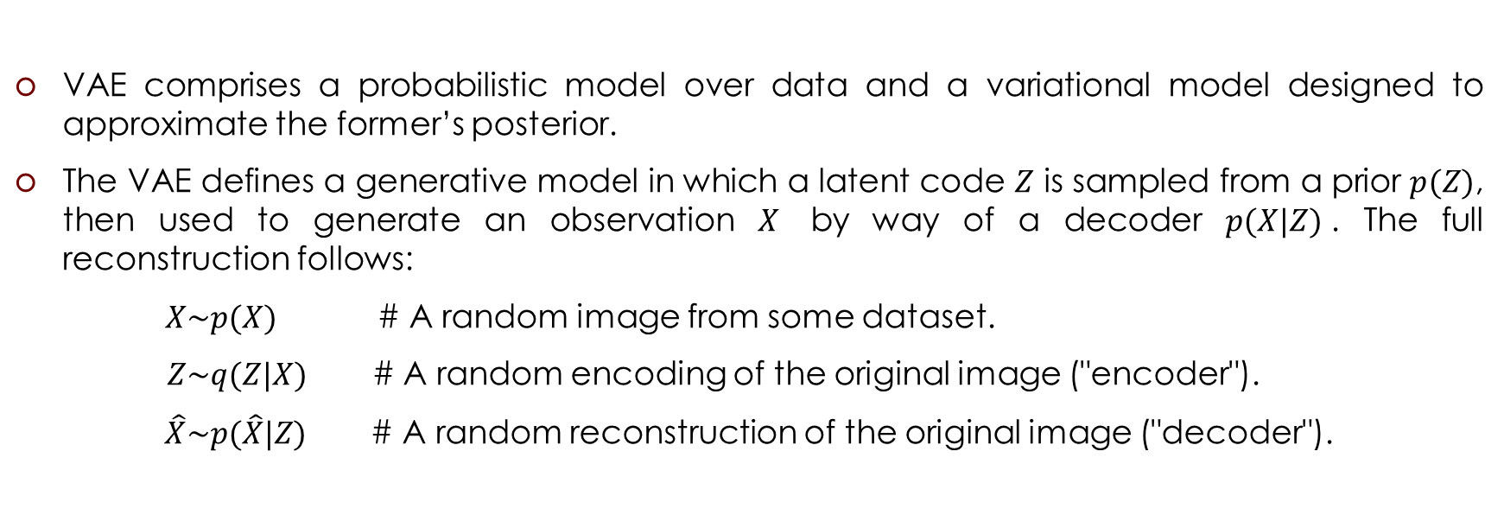
VAE
VAE comprises a probabilistic model over data and a variational model designed to approximate the former’s posterior.
The VAE defines a generative model in which a latent code $Z$ is sampled from a prior $p(Z)$, then used to generate an observation $X$ by way of a decoder $p(X|Z)$. The full reconstruction follows:
$X\sim p(X)$ # A random image from some dataset.
$Z\sim q(Z|X)$ # A random encoding of the original image ("encoder").
$\hat{X}\sim p(\hat{X}|Z)$ # A random reconstruction of the original image ("decoder").

Slide 37
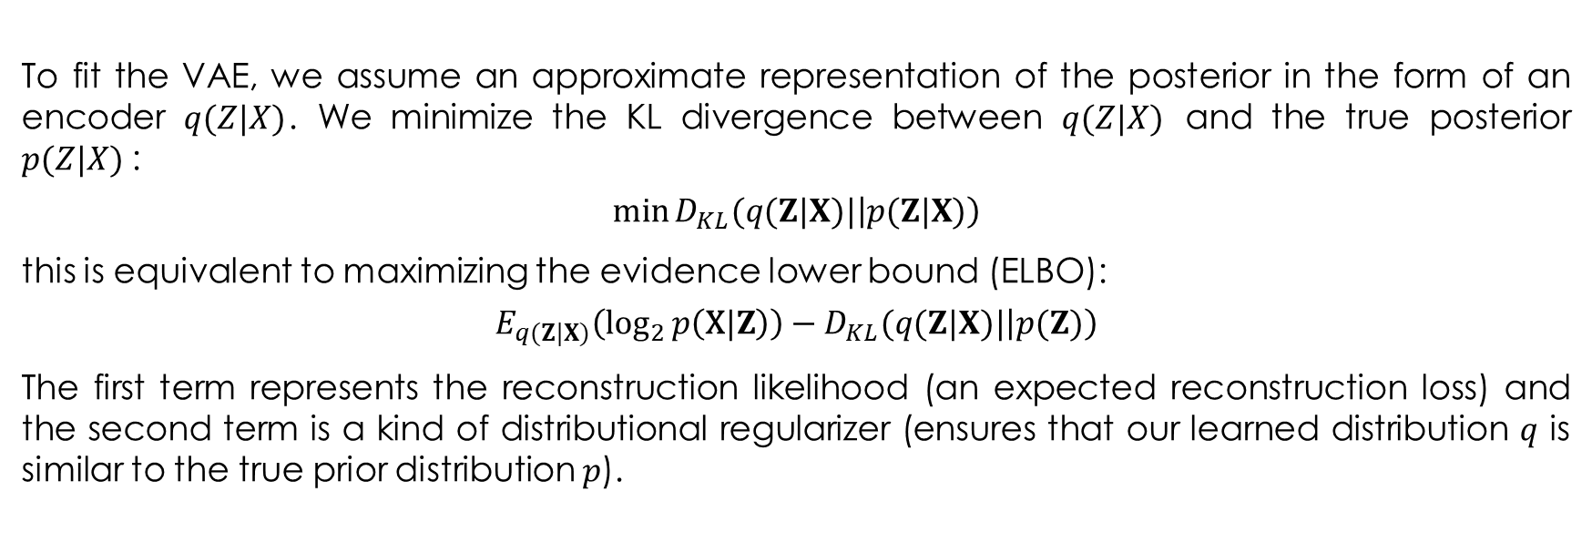
VAE Loss unction
To fit the VAE, we assume an approximate representation of the posterior in the form of an encoder $q(Z|X)$. We minimize the KL divergence between $q(Z|X)$ and the true posterior $p(Z|X)$:
$$\min{D_{KL}(q(Z|X)|\left|p(Z|X)\right)}$$
this is equivalent to maximizing the evidence lower bound (ELBO):
$$E_{q(Z|X)}\left(\log_{2}{p\left(\text{X}\text{|}Z\right)}\right)−D_{KL}(q(Z|X)|\left|p(Z)\right)$$
The first term represents the reconstruction likelihood (an expected reconstruction loss) and the second term is a kind of distributional regularizer (ensures that our learned distribution $q$ is similar to the true prior distribution $p$).

Slide 38
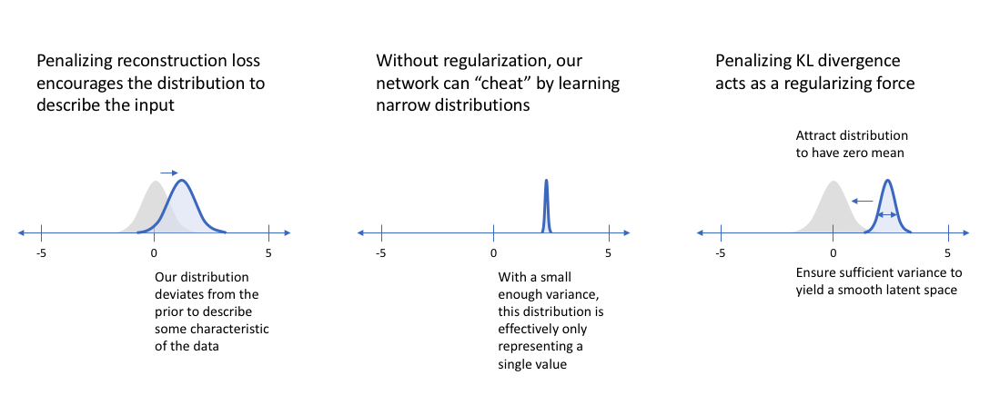
VAE Loss unction

Slide 39

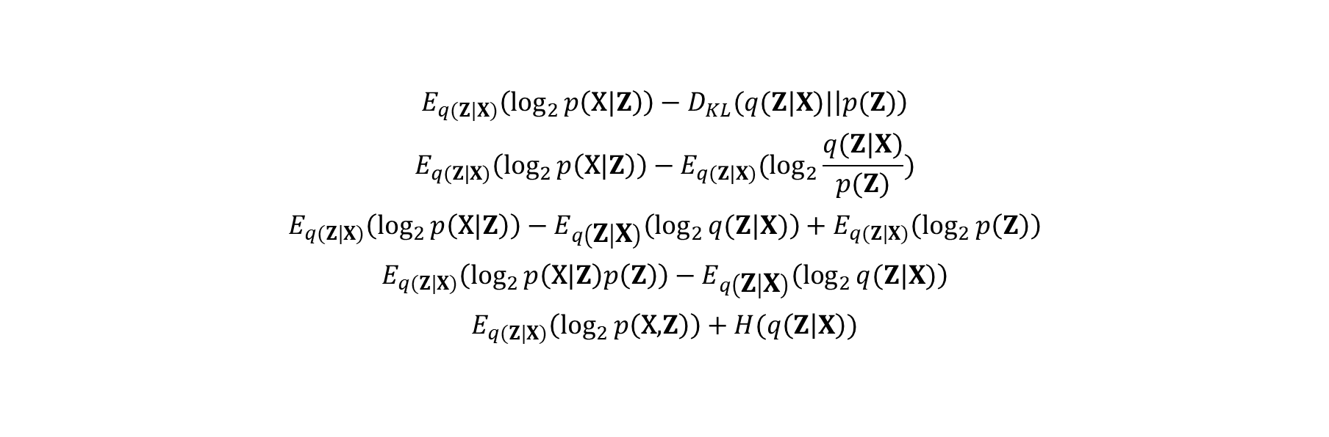

VAE Loss unction
$$D_{KL}(p|\left|q\right)=E_{p}\log_{2}{\frac{p\left(x\right)}{q\left(x\right)}}$$
$$E_{q(Z|X)}\left(\log_{2}{p\left(\text{X}\text{|}Z\right)}\right)−D_{KL}(q(Z|X)|\left|p(Z)\right)$$
$$E_{q(Z|X)}\left(\log_{2}{p\left(\text{X}\text{|}Z\right)}\right)−E_{q(Z|X)}(\log_{2}{\frac{q(Z|X)}{p(Z)})}$$
$$E_{q(Z|X)}\left(\log_{2}{p\left(\text{X}\text{|}Z\right)}\right)−E_{q\left(Z | X\right)}\left(\log_{2}{q(Z|X)}\right)+E_{q(Z|X)}\left(\log_{2}{p\left(Z\right)}\right)$$
$$E_{q(Z|X)}\left(\log_{2}{p\left(\text{X}\text{|}Z\right)p\left(Z\right)}\right)−E_{q\left(Z | X\right)}\left(\log_{2}{q(Z|X)}\right)$$
$$E_{q(Z|X)}\left(\log_{2}{p\left(\text{X}\text{,}Z\right)}\right)+H(q\left(Z | X\right))$$
$$H\left(X\right)=−\sum_{x∈X}{p(x)\log_{2}{p\left(x\right)}}$$

Slide 40
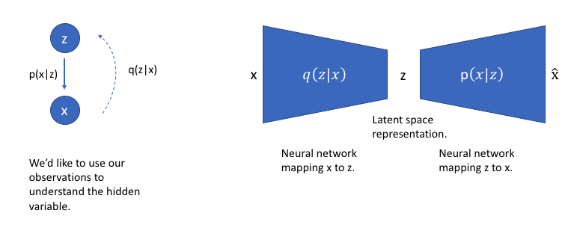
VAE
We can further construct the VAE probabilistic model into a neural network architecture where the encoder model learns a mapping from $X$ to $Z$ and the decoder model learns a mapping from $Z$ back to $X$.

Slide 41
VAE
Rather than directly outputting values for the latent state as we would in a standard autoencoder, the encoder model of a VAE will output parameters describing a distribution for each dimension in the latent space. If we're assuming that our prior follows a normal distribution, we'll output two vectors describing the mean and variance of the latent state distributions. If we were to build a true multivariate Gaussian model, we'd need to define a covariance matrix describing how each of the dimensions are correlated. However, we'll make a simplifying assumption that our covariance matrix only has nonzero values on the diagonal, allowing us to describe this information in a simple vector.

Slide 42
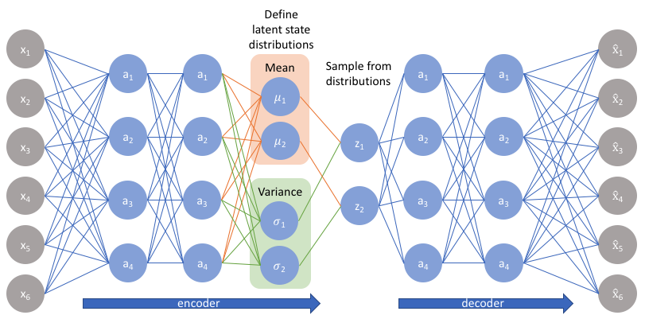
VAE

Slide 43
VAE in TFP and Keras
xdim, d, zdim = 784, 200, 2
gen_net = tf.keras.Sequential([tf.keras.layers.Dense(d, activation=tf.nn.elu),
tf.keras.layers.Dense(d, activation=tf.nn.elu),
tf.keras.layers.Dense(xdim, activation=None)])
inference_net = tf.keras.Sequential([tf.keras.layers.Dense(d, activation=tf.nn.elu),
tf.keras.layers.Dense(d, activation=tf.nn.elu),
tf.keras.layers.Dense(2*zdim, activation=None)])

Slide 44
VAE in TFP and Keras
def generative_model(batch_size=None):
z = ed.MultivariateNormalDiag(loc=tf.zeros([zdim]), scale_identity_multiplier=1.,
sample_shape=batch_size, name='z')
x = ed.Bernoulli(gen_net(z), name='x')
return x
def variational_model(x):
outs = inference_net(x)
_loc, _scale = outs[:, :zdim], 1e-3 + tf.nn.softplus(outs[:, zdim:])
z = ed.MultivariateNormalDiag(loc=_loc, scale_diag=_scale, name='z_posterior')
return z
log_joint = ed.make_log_joint_fn(generative_model)

Slide 45
VAE in TFP and Keras
def get_loss(inputs):
z = variational_model(inputs)
energy = log_joint(z=z, x=inputs)
entropy = tf.reduce_sum(z.distribution.entropy())
return (-energy - entropy)

Slide 46
VAE in TFP and Keras
mnist = tf.keras.datasets.mnist
(x_train, _), _ = mnist.load_data()
x_train = np.rint((x_train / 255.).reshape(-1, xdim)).astype(np.float32)
assert x_train.max() <= 1 and x_train.min() >= 0 #assert correctly
bs = 64
dataset = tf.data.Dataset.from_tensor_slices(x_train)
dataset = dataset.shuffle((len(x_train)))
dataset = dataset.batch(bs, drop_remainder=True)
dataset = dataset.prefetch(16)
data_iterator = dataset.make_initializable_iterator()
batch_x = data_iterator.get_next()
loss = get_loss(batch_x) / bs # divide by bs since loss is summed.
opt = tf.contrib.opt.AdamWOptimizer(0, learning_rate=1e-3)
train = opt.minimize(loss)

Slide 47
VAE in TFP and Keras
init = tf.global_variables_initializer()
sess = tf.Session()
sess.run(init)
for i in range(50): # 50 epochs; takes <2m on my GPU.
sess.run(data_iterator.initializer)
try:
while True:
_, _loss = sess.run([train, loss])
except tf.errors.OutOfRangeError:
print(_loss, ', end of epoch {}'.format(i))

Slide 48
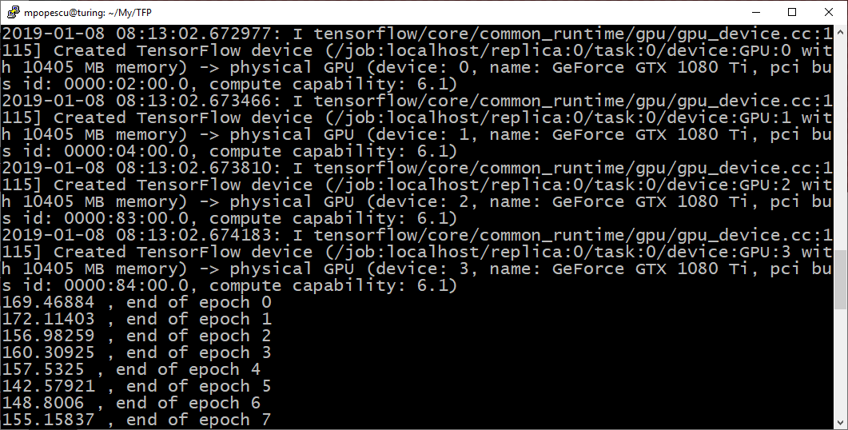
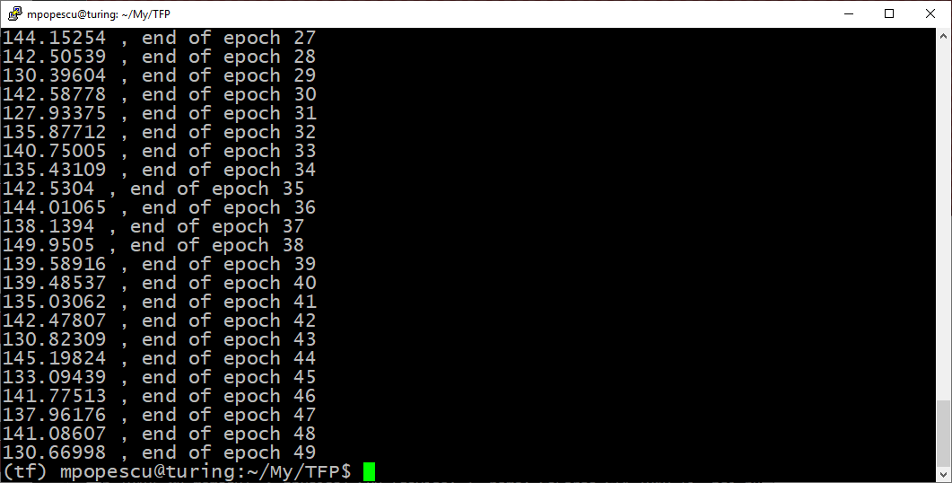
Training

Slide 49
VAE as a Generative Model
# Generate imgs.
generated = generative_model(batch_size=64)
img = sess.run(generated).reshape(-1, 28, 28)
plt.figure(figsize=(16, 4))
for i in range(64):
plt.subplot(4, 16, i+1)
plt.imshow(img[i], cmap='Greys')
plt.axis('off')
plt.savefig('vae1.png')
plt.show()

Slide 50
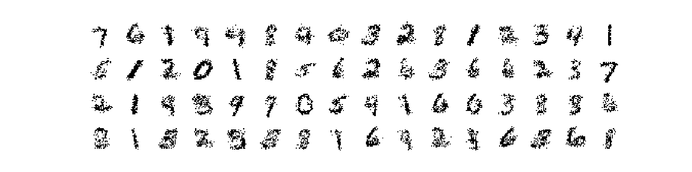
The Results

Slide 51
Reconstruct Images
# Reconstruct imgs. Left is original, right is reconstructed.
batch = batch_x
var_z = variational_model(batch)
with ed.interception(replace_z(z=var_z)):
recon = generative_model()
sess.run(data_iterator.initializer)
_batch, _recon = sess.run([batch, recon])
_batch, _recon = _batch.reshape(-1, 28, 28), _recon.reshape(-1, 28, 28)
plt.figure(figsize=(16, 4))
for i in range(32):
plt.subplot(4, 16, 2*i+1)
plt.imshow(_batch[i], cmap='Greys')
plt.axis('off')
plt.subplot(4, 16, 2*i+2)
plt.imshow(_recon[i], cmap='Greys')
plt.axis('off')
plt.savefig('vae2.png')
plt.show()
def replace_z(z):
def interceptor(rv_constructor, *rv_args, **rv_kwargs):
name = rv_kwargs.pop('name')
if name == 'z':
rv_kwargs['value'] = z
return rv_constructor(*rv_args, **rv_kwargs)
return interceptor

Slide 52
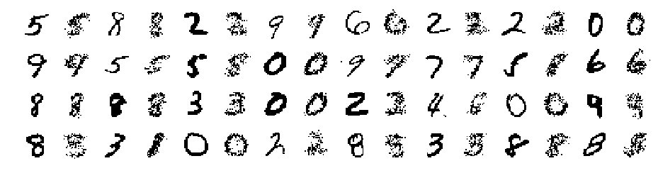
The Results

Slide 53
Visualization of Latent Space
from scipy.stats import norm
N = 20
invcdf = norm.ppf(np.linspace(.1, .9, num=N))
zs = [[invcdf[i], invcdf[j]] for i in range(N) for j in range(N)]
with ed.interception(replace_z(z=zs)):
recon = generative_model(N*N)
sess.run(data_iterator.initializer)
_recon = sess.run(recon).reshape(-1, 28, 28)
_batch, _recon = _batch.reshape(-1, 28, 28), _recon.reshape(-1, 28, 28)
plt.figure(figsize=(16, 16))
for i in range(N):
for j in range(N):
plt.subplot(N, N, N*j+i+1)
plt.imshow(_recon[N*j+i], cmap='Greys')
plt.axis('off')
plt.savefig('vae3.png')
plt.show()

Slide 54
